Slide 1

Master Prompt Engineering
Fundamental LLM Concepts

Slide 2
Operations

Slide 3

Reductive Operations
Take a large amount of text and produce a smaller output. Input is larger than the output.
Summarization: Say the same thing with fewer words.
Can use list, notes, executive summary.
Distillation: Purify the underlying principles or facts.
Remove all the noise, extract axioms, foundations, etc.
Extraction: Retrieve specific kinds of information.
Question answering, listing names, extracting dates, etc.
Characterizing: Describe the content of the text.
Describe either the text as a whole, or within the subject.
Analyzing: Find patterns or evaluate against a framework.
Structural analysis, rhetorical analysis, etc
Evaluation: Measuring, grading, or judging the content.
Grading papers, evaluating against morals
Critiquing: Provide feedback within the context of the text.
Provide recommendations for improvement

Slide 4

Transformation Operations
Transmute the input into another format. Input and output are roughly the same size and/or meaning.
Reformatting: Change the presentation only.
Prose to screenplay, XML to JSON
Refactoring: Achieve same results with more efficiency.
Say the same exact thing, but differently
Language Change: Translate between languages.
English to Russian, C++ to Python
Restructuring: Optimize structure for logical flow, etc.
Change order, add or remove structure
Modification: Rewrite copy to achieve different intention.
Change tone, formality, diplomacy, style, etc
Clarification: Make something more comprehensible.
Embellish or more clearly articulate

Slide 5
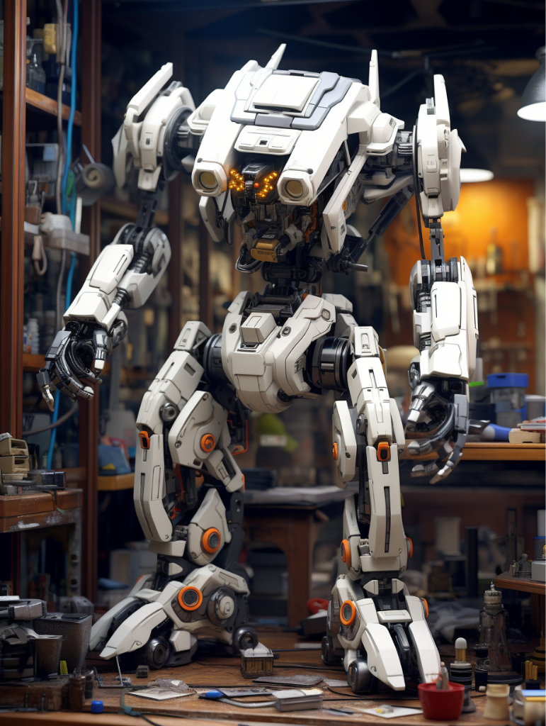
Generative Operations
Generate a large amount of text from a small set of instructions or data. Input is smaller than the output.
Drafting: Generate a draft of some kind of document.
Code, fiction, legal copy, KB, science, storytelling
Planning: Given parameters, come up with plans.
Actions, projects, objectives, missions, constraints, context.
Brainstorming: Use imagine to list out possibilities.
Ideation, exploration of possibilities, problem solving, hypothesizing
Amplification: Articulate and explicate something further.
Expanding and expounding, riffing on stuff

Slide 6
Latent & Emergent

Slide 7
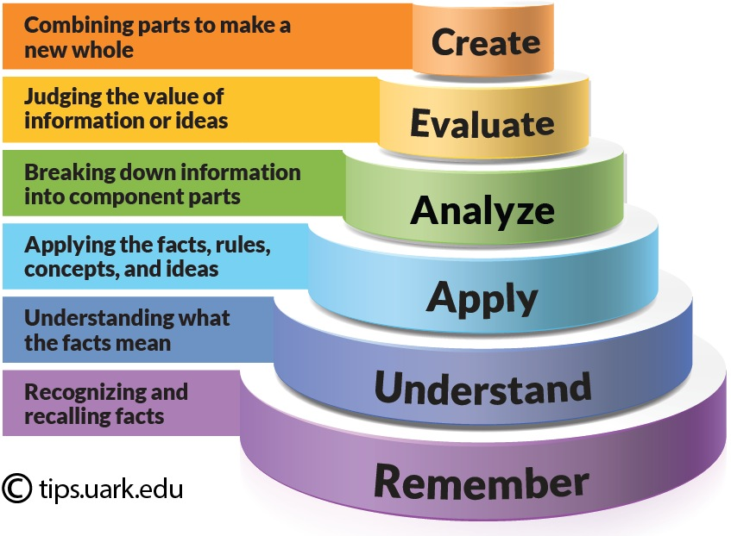
Bloom’s Taxonomy
A hierarchical model to classify educational learning objectives into varying complexity and specificity.
Remembering: Recalling facts and concepts.
Retrieval and regurgitation
Understanding: Explaining ideas and concepts.
Connecting words to meanings.
Applying: Using information in new situations.
Functional utility
Analyzing: Drawing connections among ideas.
Connecting the dots between concepts.
Evaluating: Justifying a decision or action.
Explication and articulation
Creating: Producing new or original work.
Generating something that did not previously exist.

Slide 8

Latent Content
Knowledge, facts, concepts, and information that is “embedded” in the model and must be “activated” by correct prompting.
Training Data: Latent content only originates from training data.
World Knowledge: General facts and understanding of the world.
Scientific Information: Embedded data on scientific principles.
Cultural Knowledge: Information on cultures and social norms.
Historical Knowledge: Data on past events and figures.
Languages: Language structures, vocabulary, and syntax.

Slide 9

Emergent Capabilities
Increasingly large models have “emergent” capabilities that are not explicitly in the training data.
Theory of Mind: Understanding the content of minds.
It’s read enough Reddit to understand how humans think.
Implied Cognition: Thinking with the right prompting.
Ability to “think” required to accurately predict next token.
Logical Reasoning: Inductive and deductive reasoning.
Triangulating principles based on observations, etc
In-Context Learning: Use information not in training.
Quickly adopt and apply truly novel information

Slide 10

Hallucination = Creativity
Hallucination is the same cognitive behavior as creativity, differing only in recognition of its fictitious nature.
Recognition: The key difference lies in acknowledging the fictitious element.
Cognitive Behavior: Both involve similar mental processes for generating ideas.
Fictitious vs Real: How the output is perceived or utilized.
Creative Applications: Hallucinations can be channeled into artistic or innovative endeavors.
Context-Dependent: The value or risk depends on the context in which it occurs.

Slide 11
Thank you

